Slide 1
CCBR1032
Da and Vishal
Our goal is to use RNA sequencing to investigate the expression changes in pathways such as DNA damage, DNA repair, cell cycle signaling, and apoptosis after treatment with a drug combination. We are using established and patient-derived human glioblastoma (brain tumor) cell lines, and treating with a drug combination that induces DNA damage, cell cycle arrest, and apoptosis. Additionally, RNA-Seq would also allow us to observe expression changes in additional pathways which could lead to identification of novel mechanisms of drug action, which we are interested in as well.

Slide 2
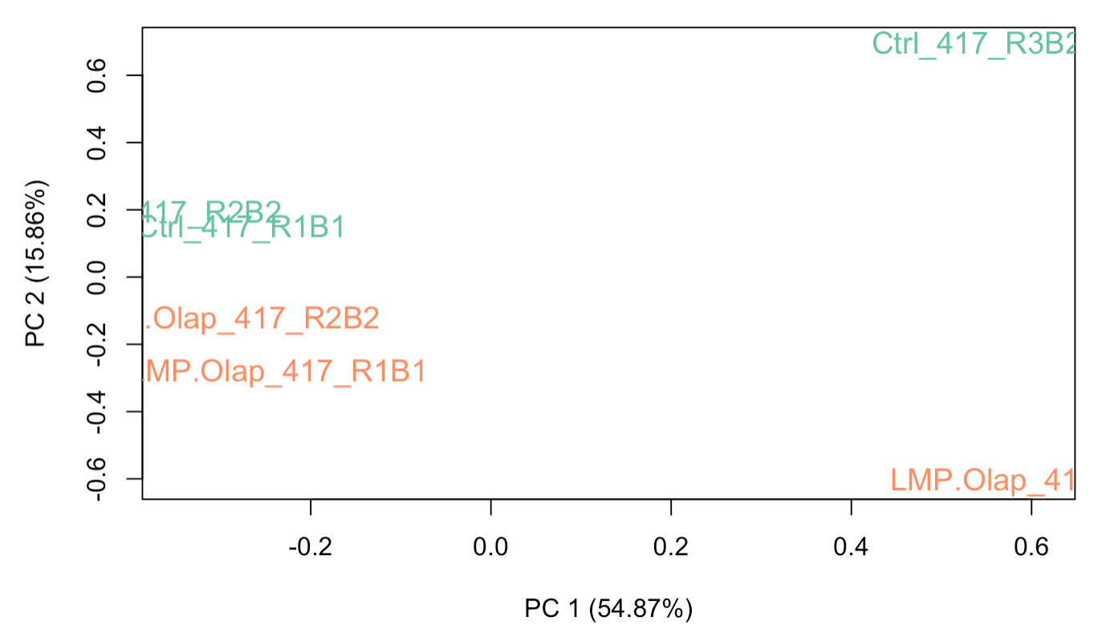
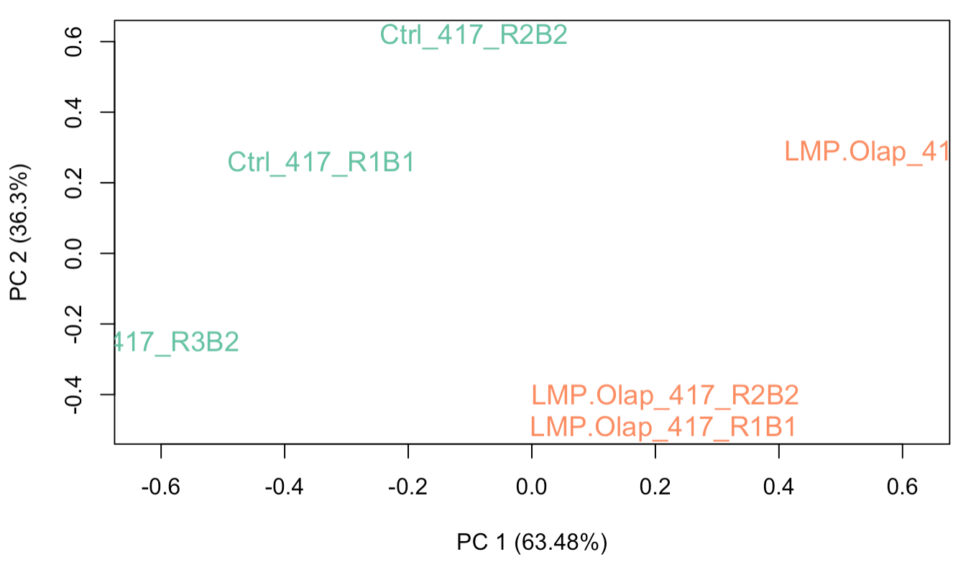
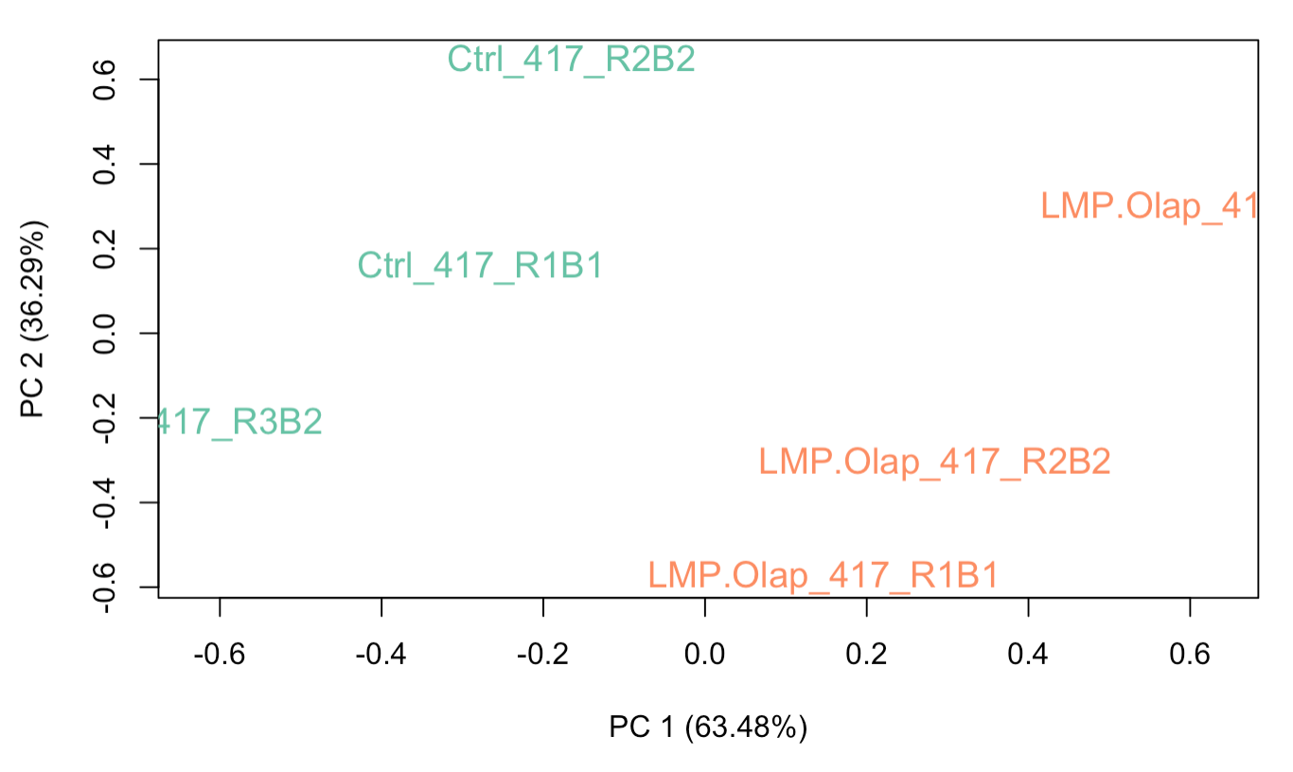
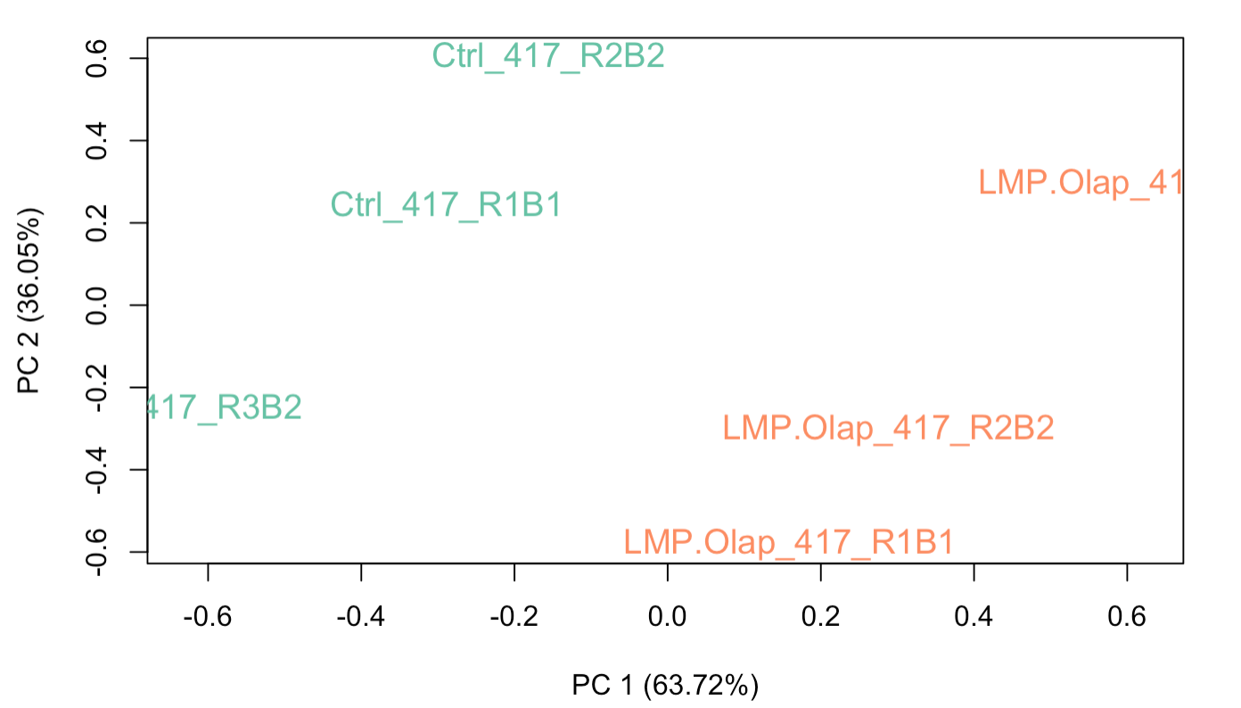
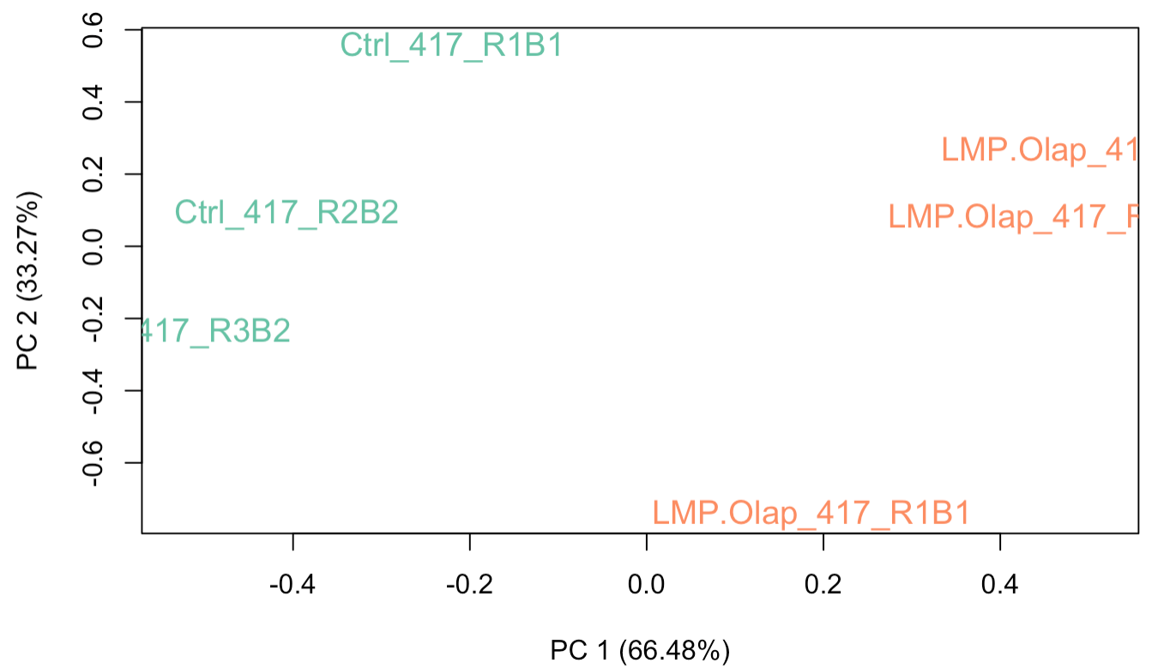
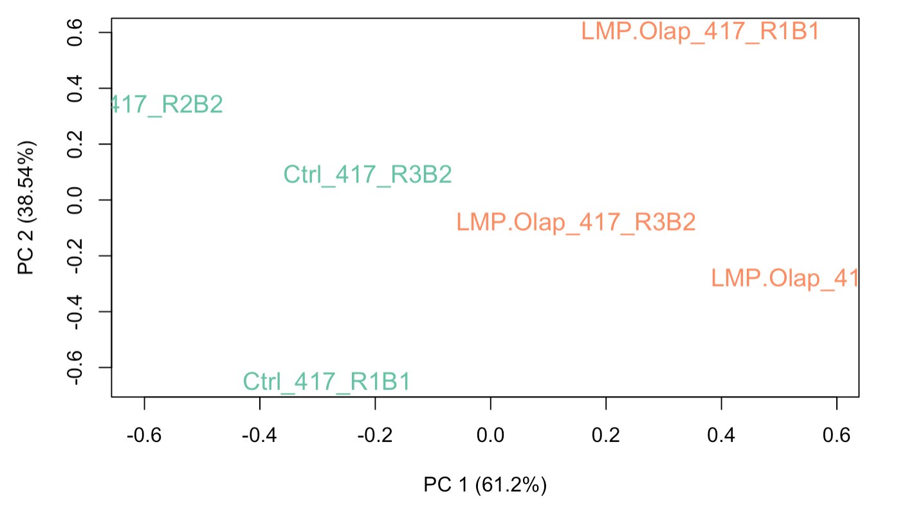
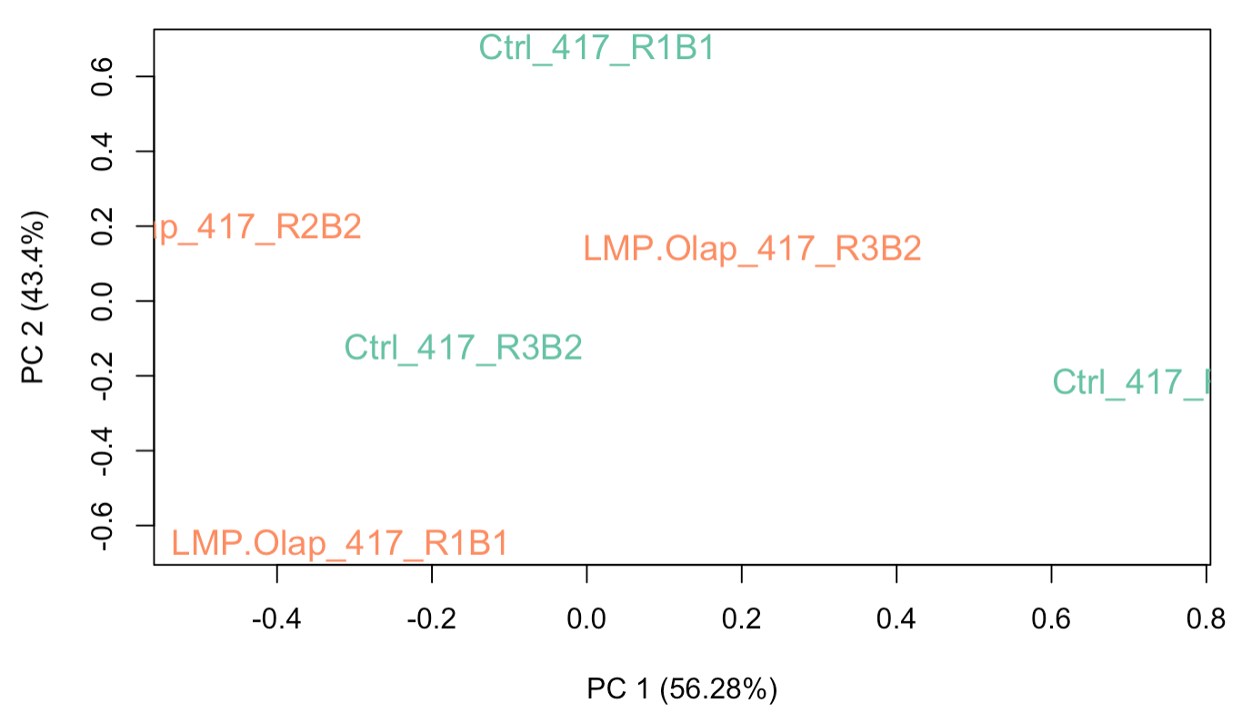
Before RUVg
Genes with the largest P values were used as control genes in RUVseq
RUVg was used to remove unwanted variation
PCA shows before RUVg and after RUVg with different number of control genes
After RUVg (200 genes with largest Pvalue as control)
After RUVg (500 genes with largest Pvalue)
After RUVg (1500 genes with largest Pvalue)
After RUVg (3000 genes with largest Pvalue)
After RUVg (13000 genes with largest Pvalue)
After RUVg (100 genes with smalles Pvalue)

Slide 4
- Ola_417-Ctrl_417 : 2
- Ola_602-Ctrl_602 : 15
- Ola_827-Ctrl_827 : 3
- Ola_923-Ctrl_923 : 1
- LMP_417-Ctrl_417 : 6
- LMP_602-Ctrl_602 : 41
- LMP_827-Ctrl_827 : 29
- LMP_923-Ctrl_923 : 38
- LMP.Olap_417-Ctrl_417 : 20
- LMP.Olap_602-Ctrl_602 : 88
- LMP.Olap_827-Ctrl_827 : 114
- LMP.Olap_923-Ctrl_923 : 415
- LMP.Olap_417-LMP_417 : 2
- LMP.Olap_602-LMP_602 : 23
- LMP.Olap_923-LMP_923 : 68
- LMP.Olap_827-LMP_827 : 8
- LMP.Olap_417-Ola_417 : 10
- LMP.Olap_602-Ola_602 : 82
- LMP.Olap_827-Ola_827 : 76
- LMP.Olap_923-Ola_923 : 222
DEGs from DEseq2:
Contrast:
Ola – Ctrl(Olaparib Vs. Control): GSC923(GSC827, SF10417, SF10602)
LMP – Ctrl(LMP400 Vs. Control): GSC923(GSC827, SF10417, SF10602)
LMP.Olap - Ctrl(LMP400+Olaparib Vs. Control): GSC923(GSC827, SF10417, SF10602)
LMP.Olap – Ola(LMP400+Olaparib Vs. Olaparib): GSC923(GSC827, SF10417, SF10602)
LMP.Olap – LMP(LMP400+Olaparib Vs. LMP400):
GSC923(GSC827, SF10417, SF10602)
treated-Ctrl(Olaparib, LMP400, LMP400+Olaparib Vs. Control):
GSC923(GSC827, SF10417, SF10602)

Slide 5

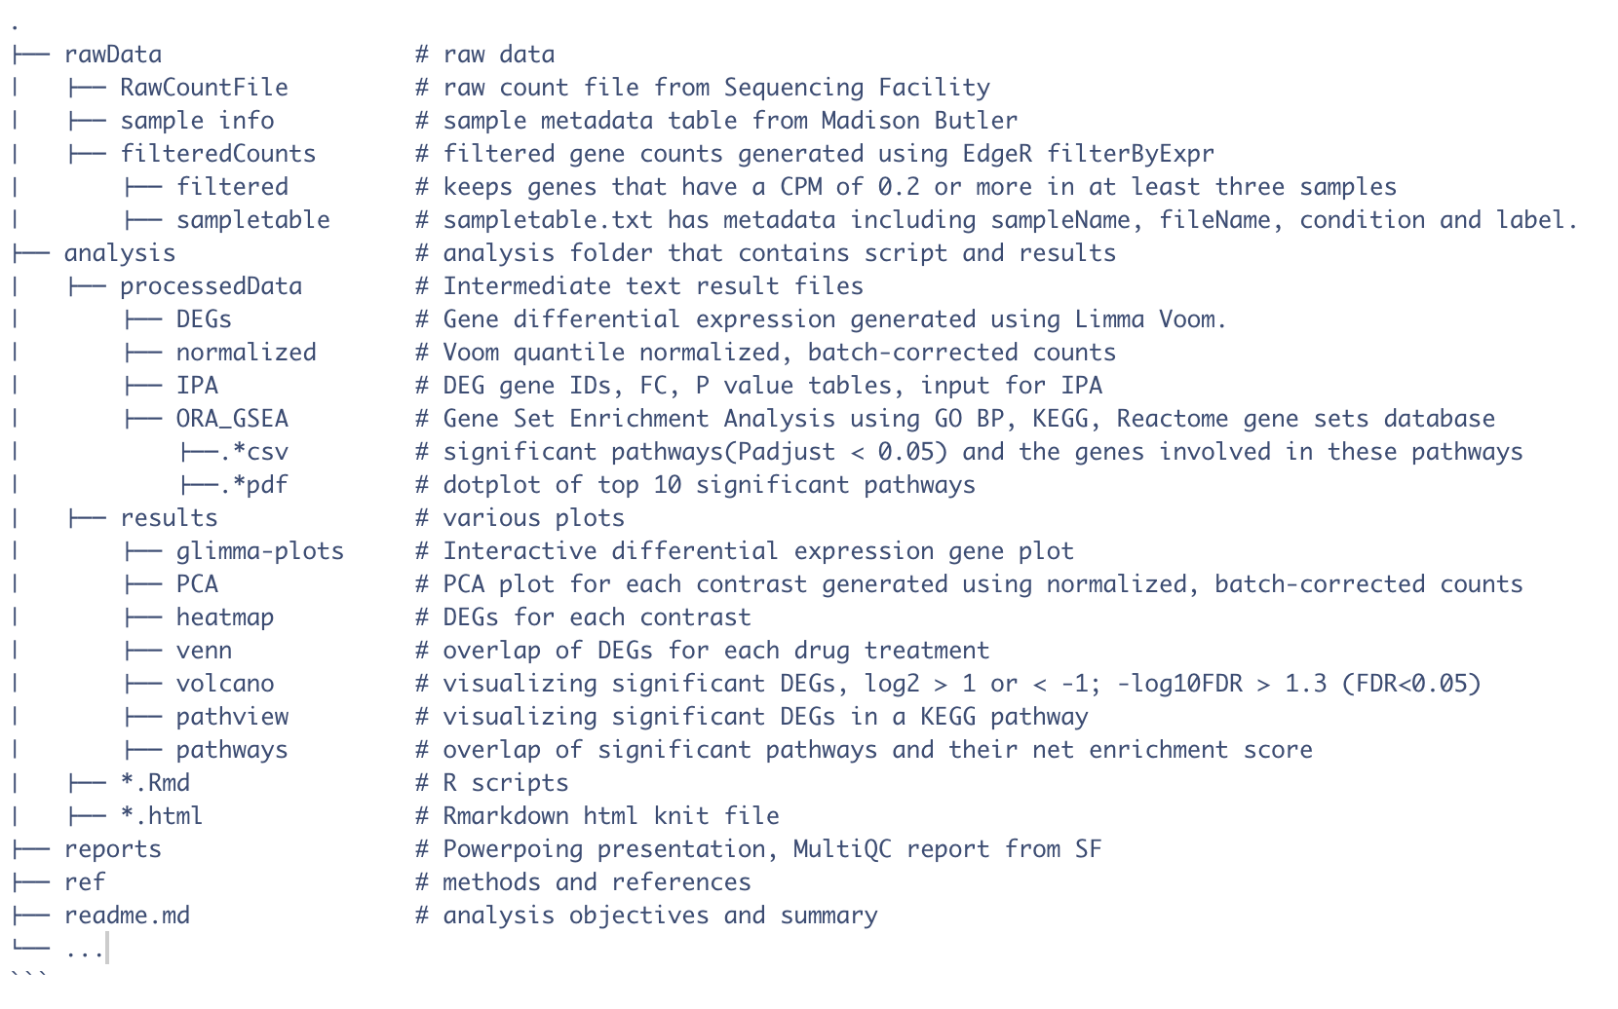

Slide 6
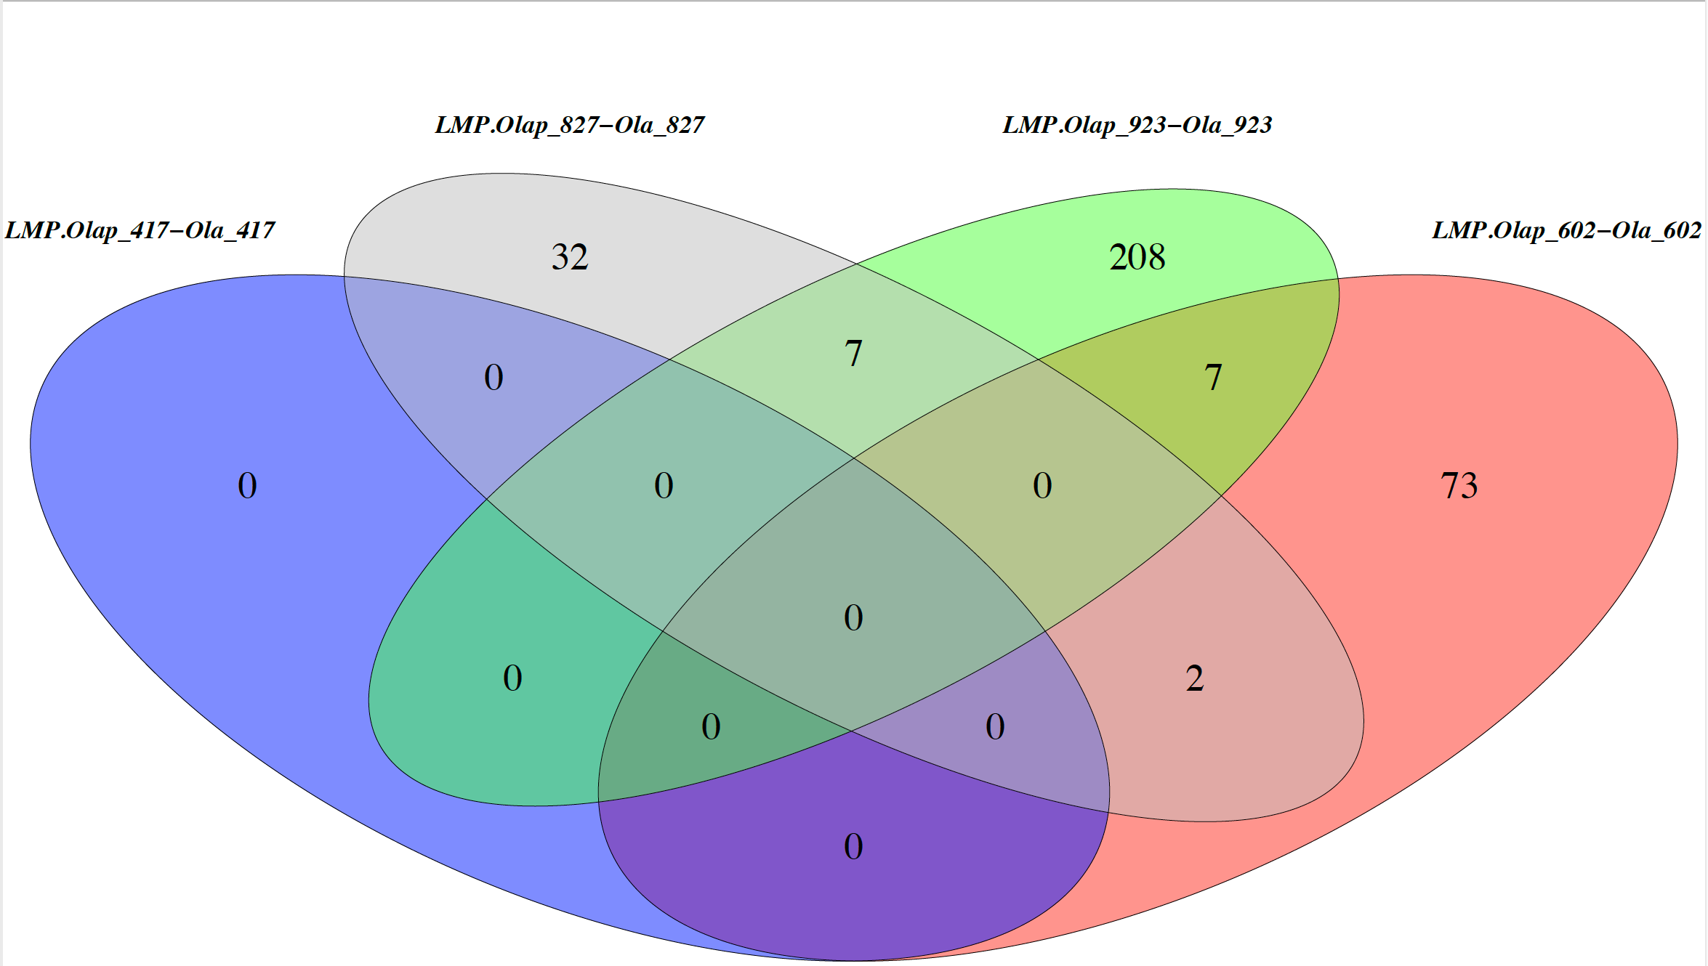
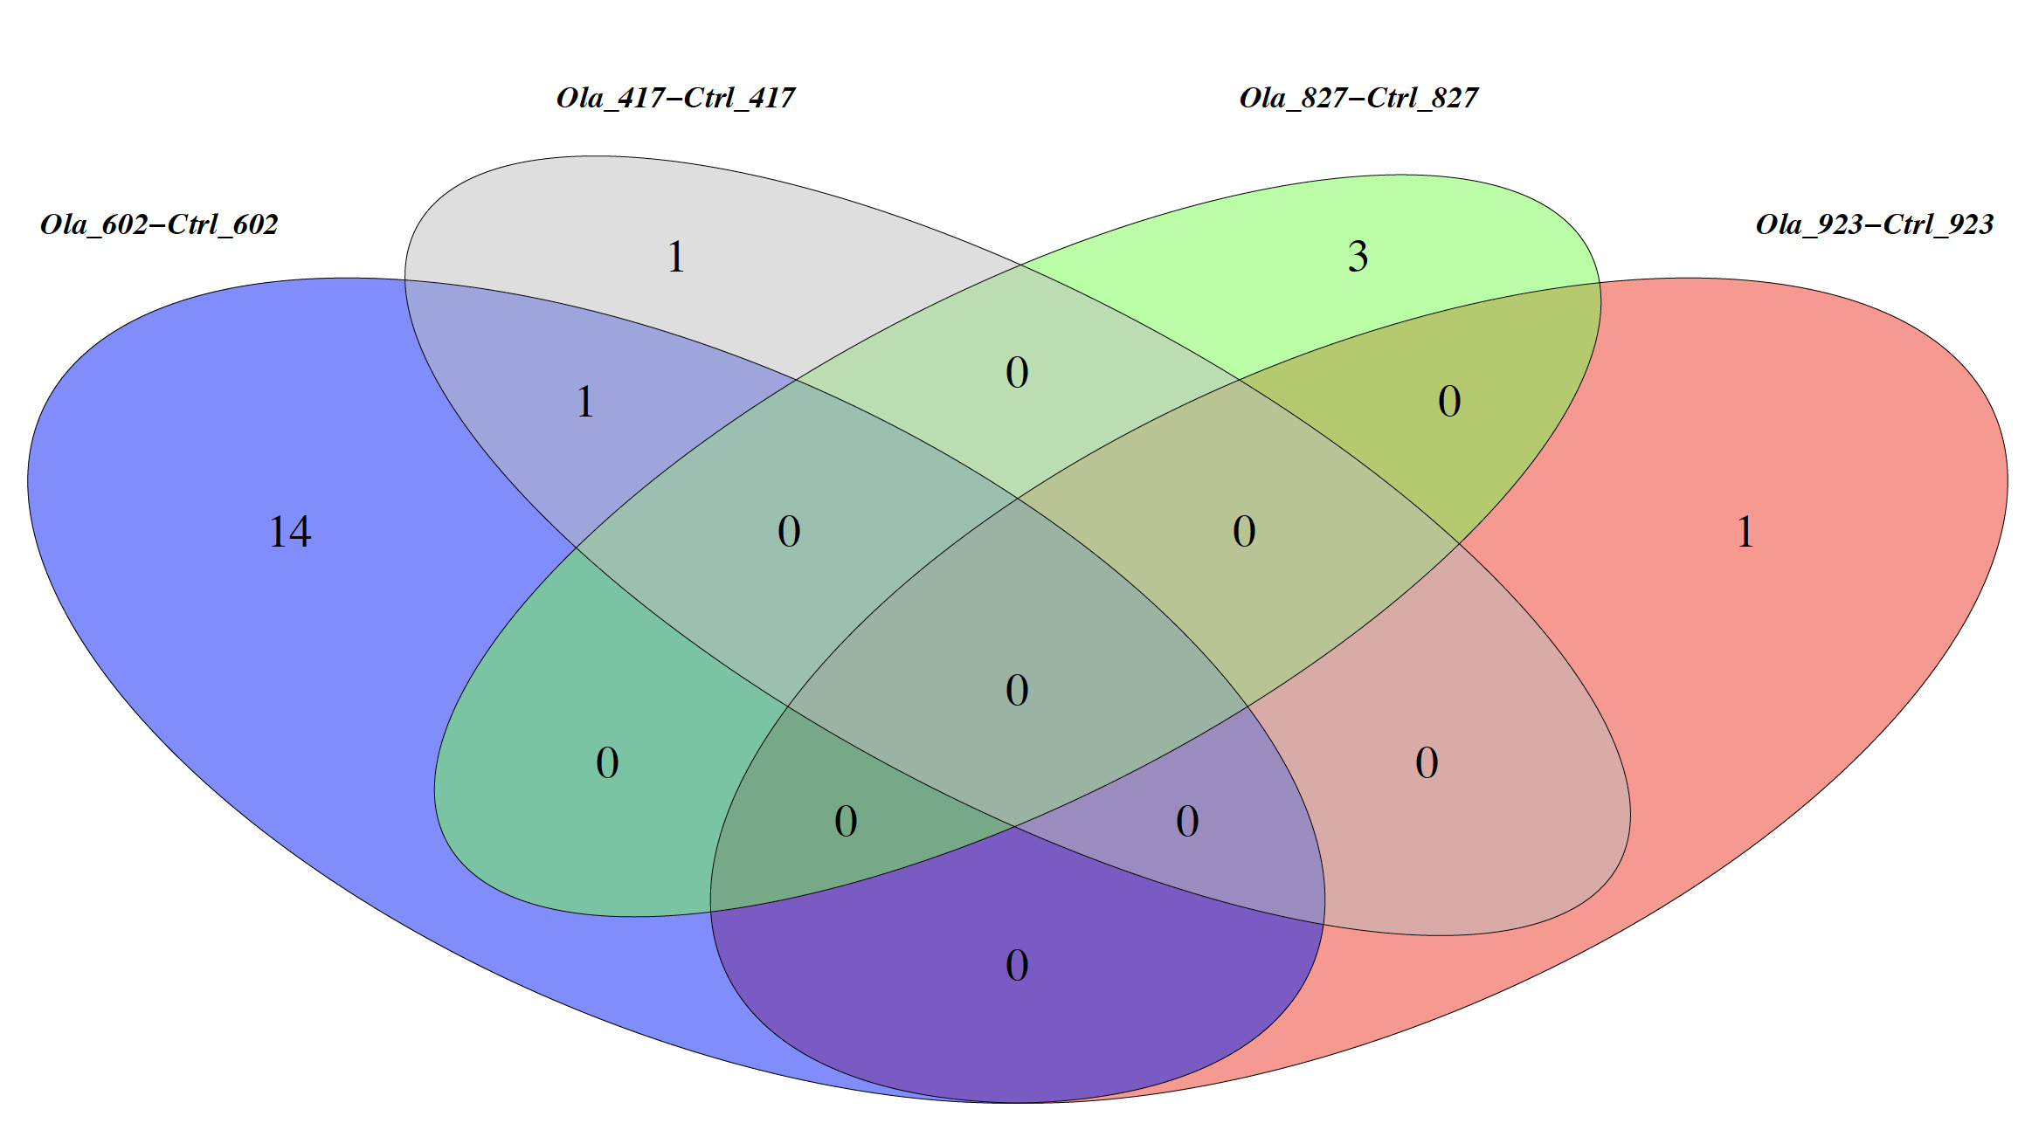
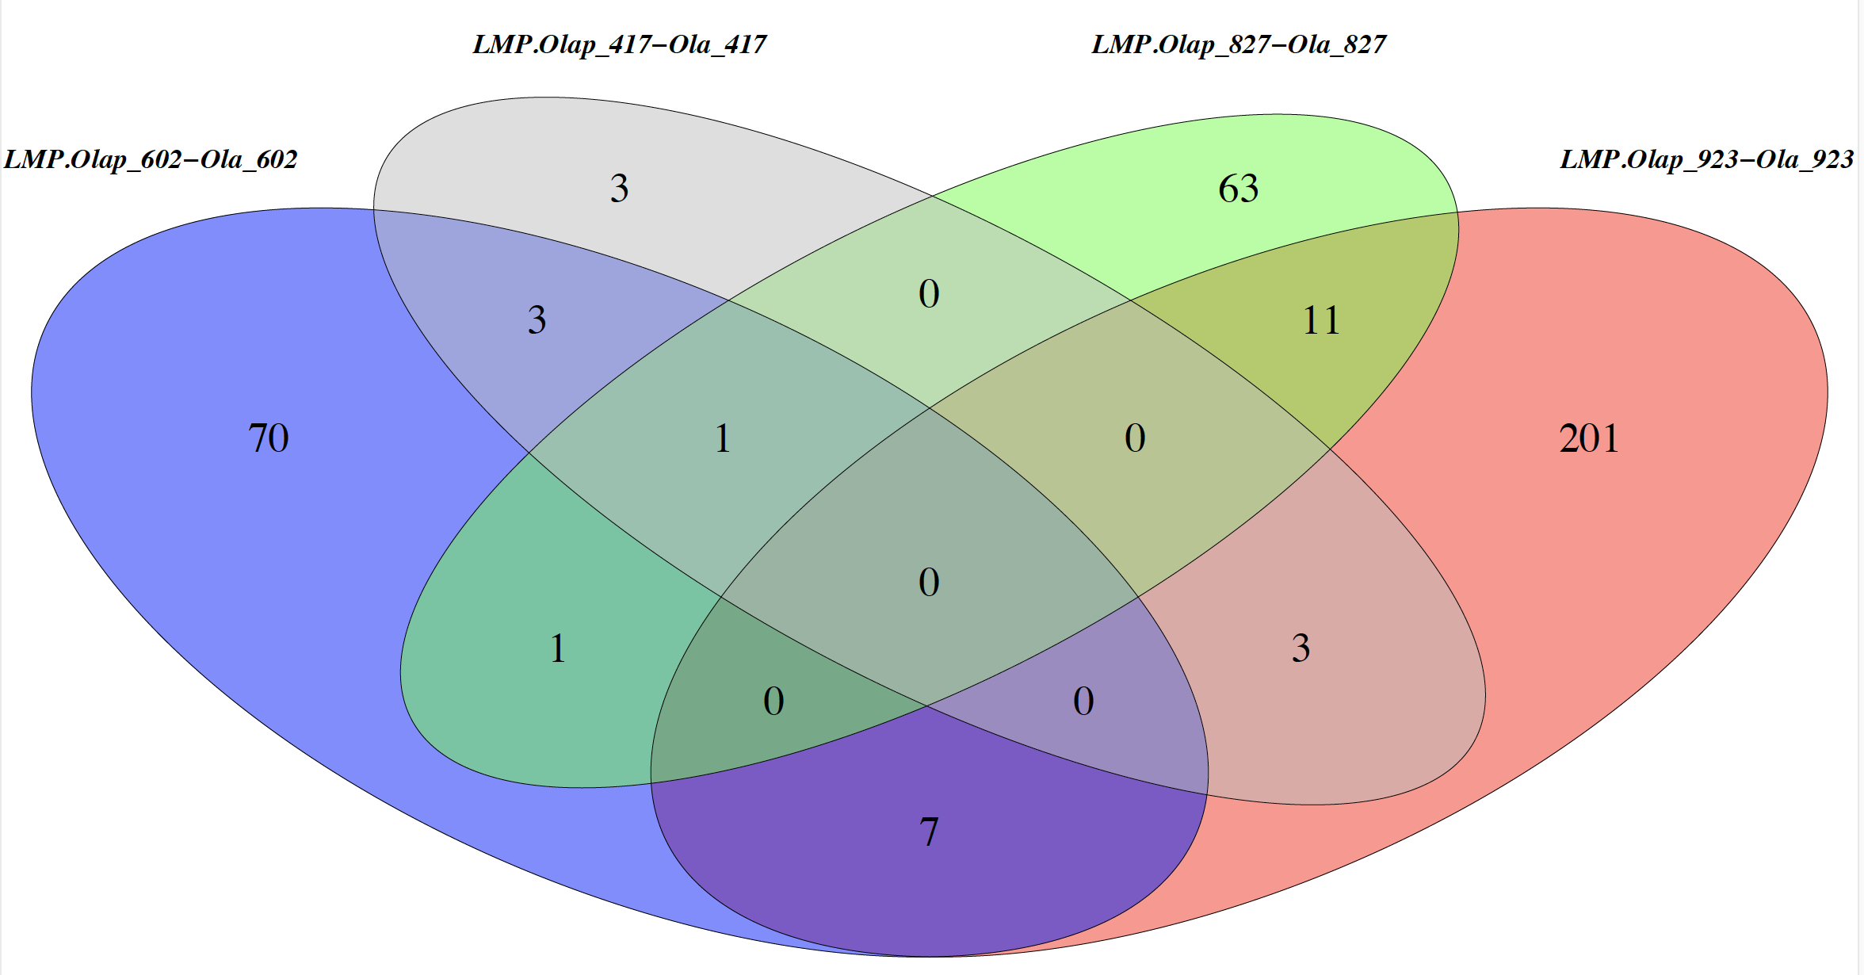
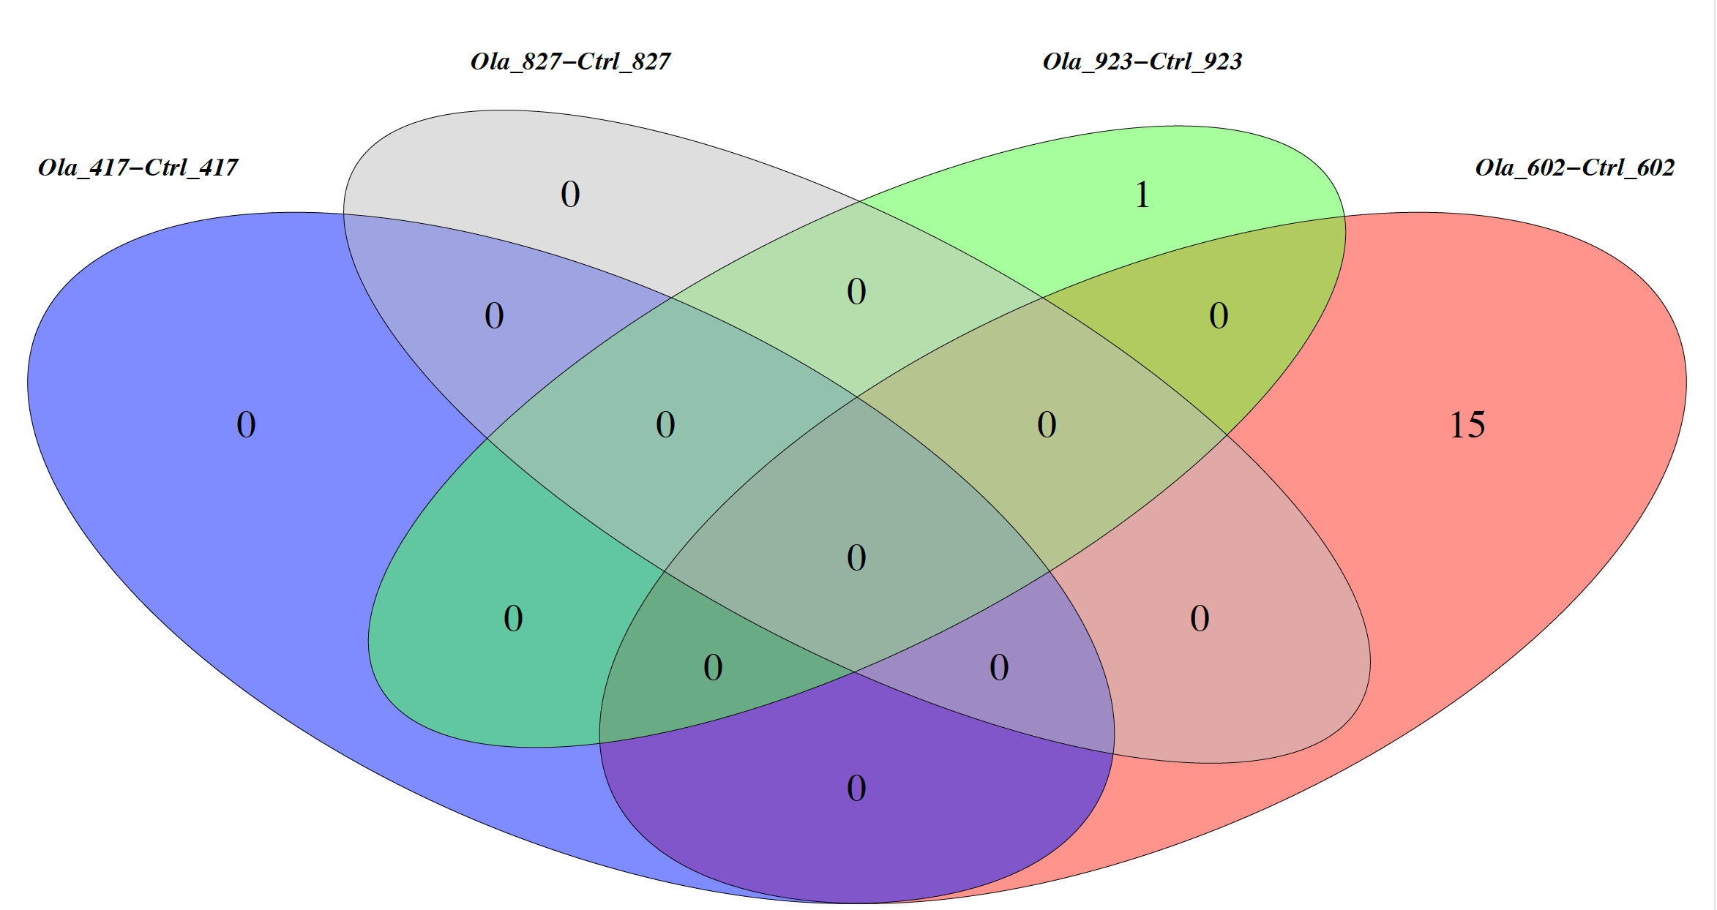

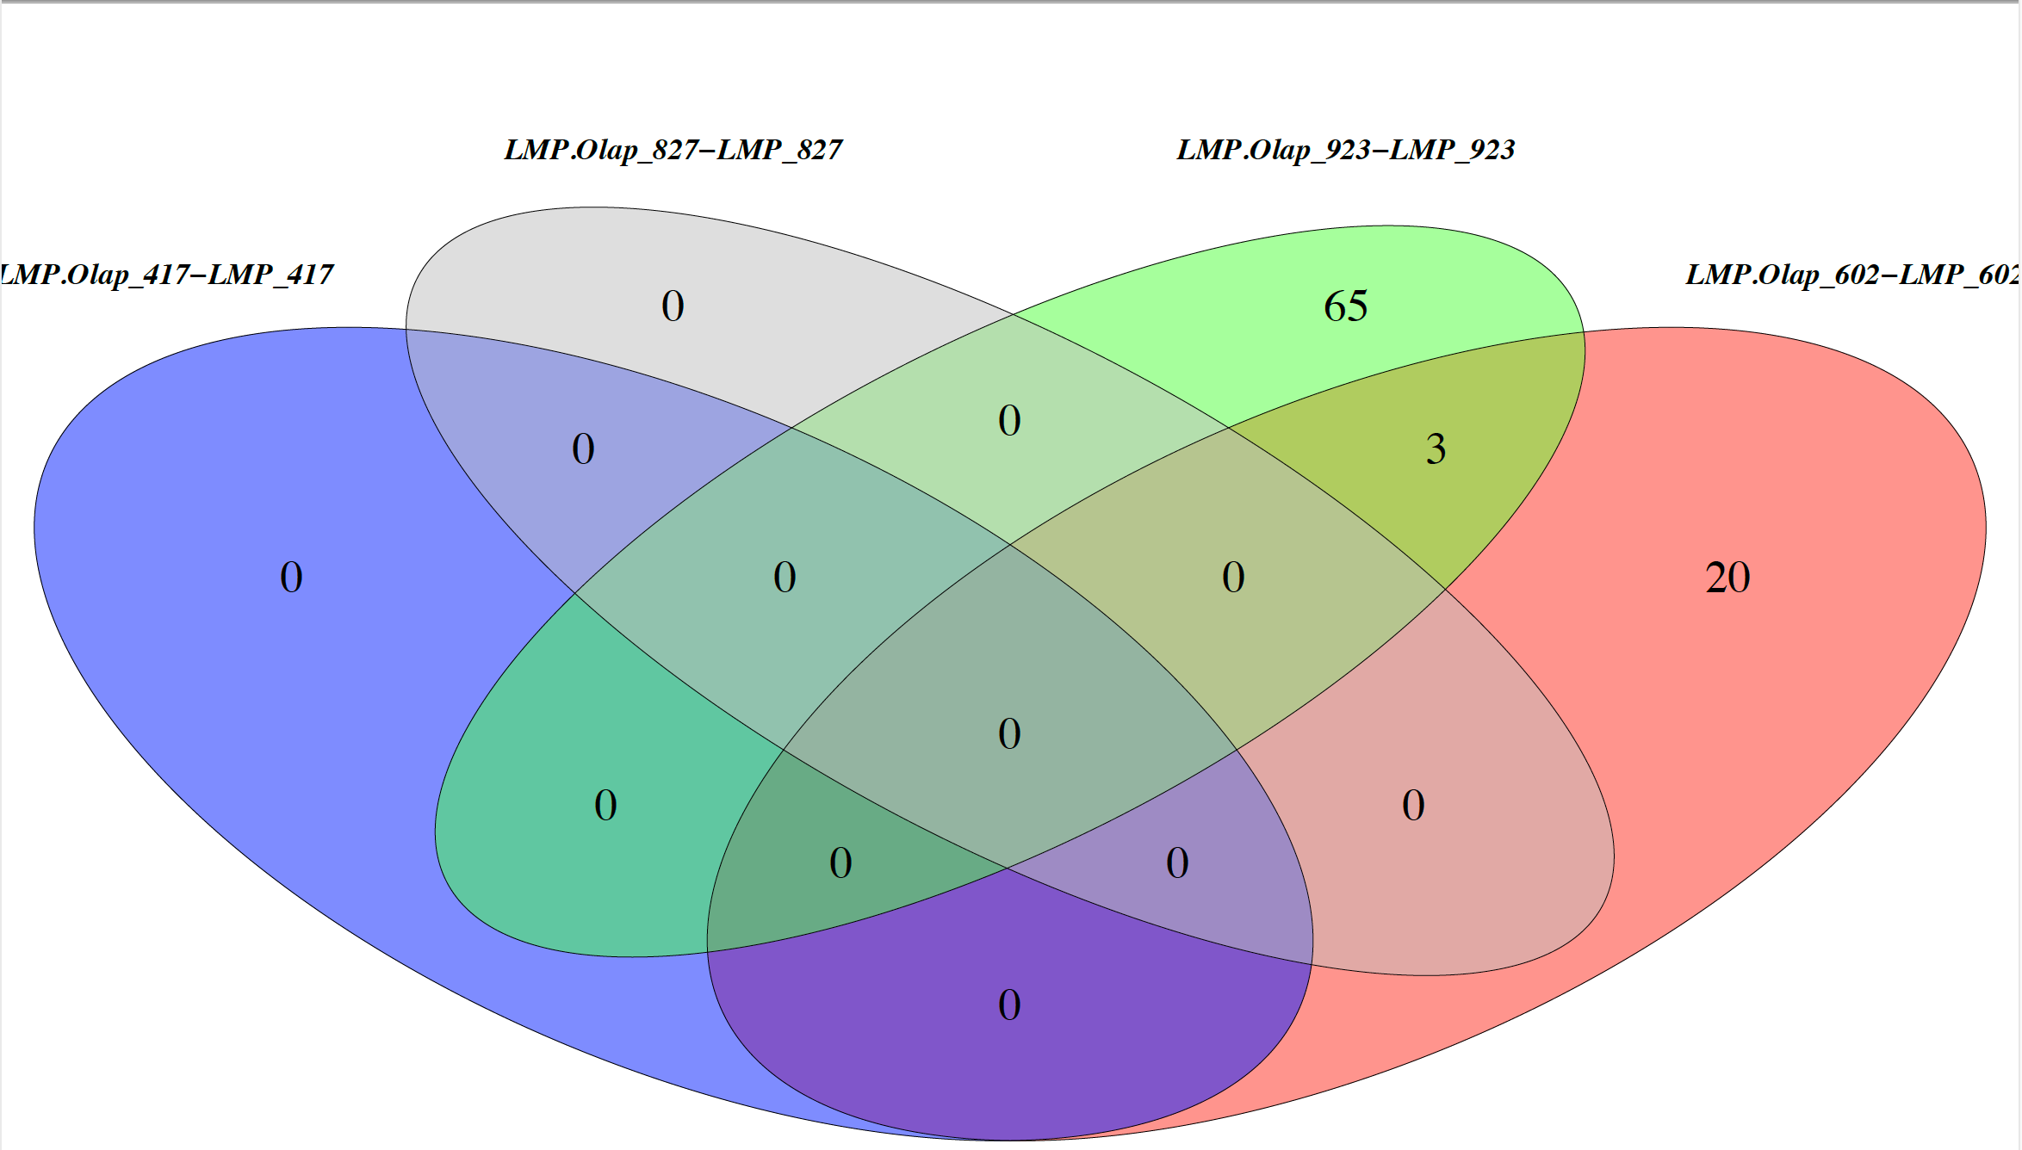

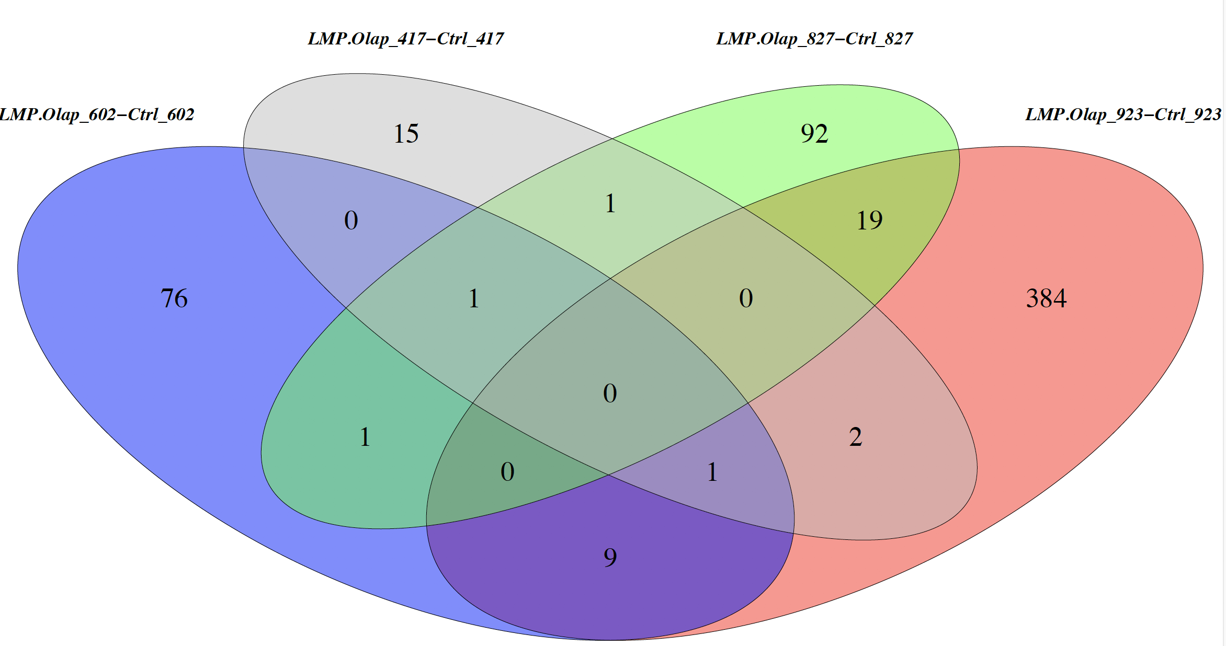
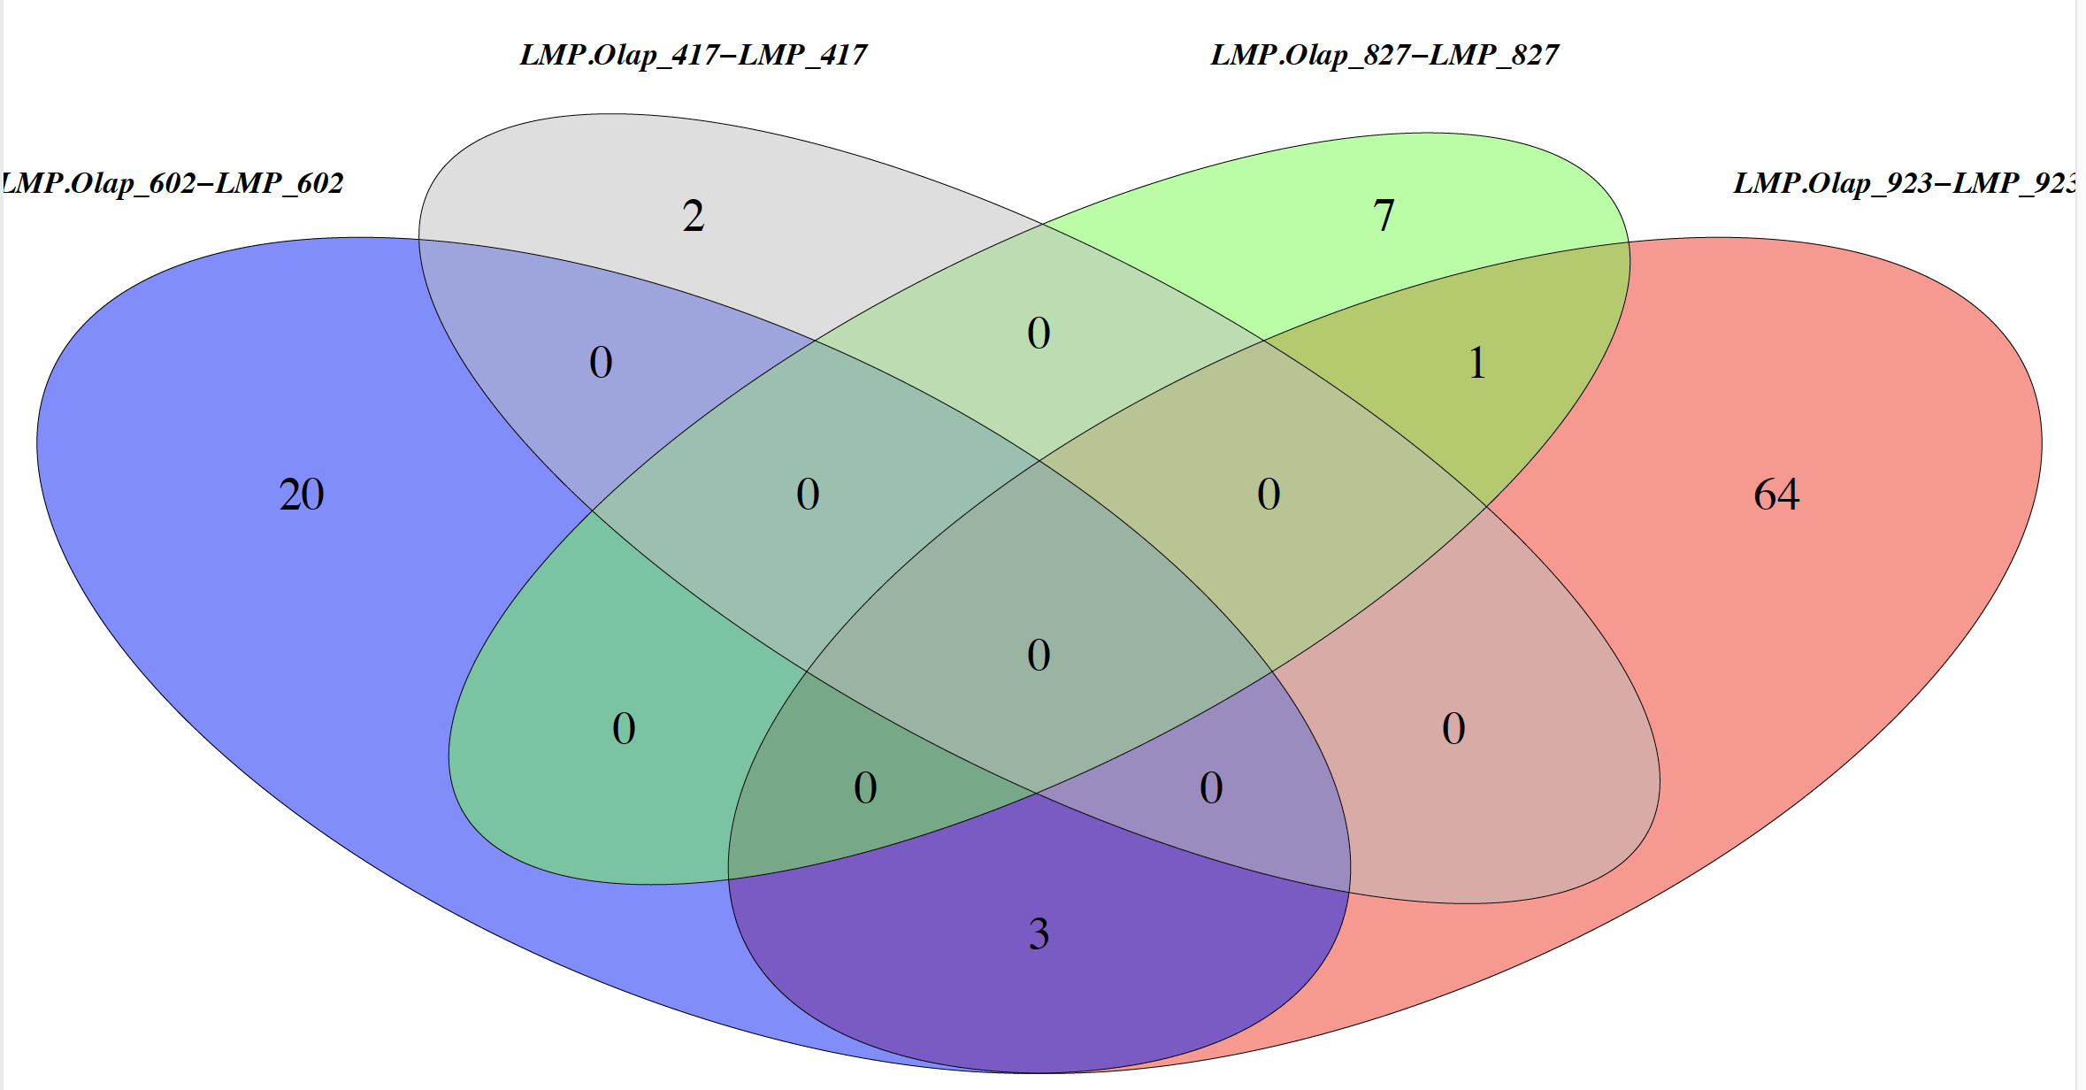
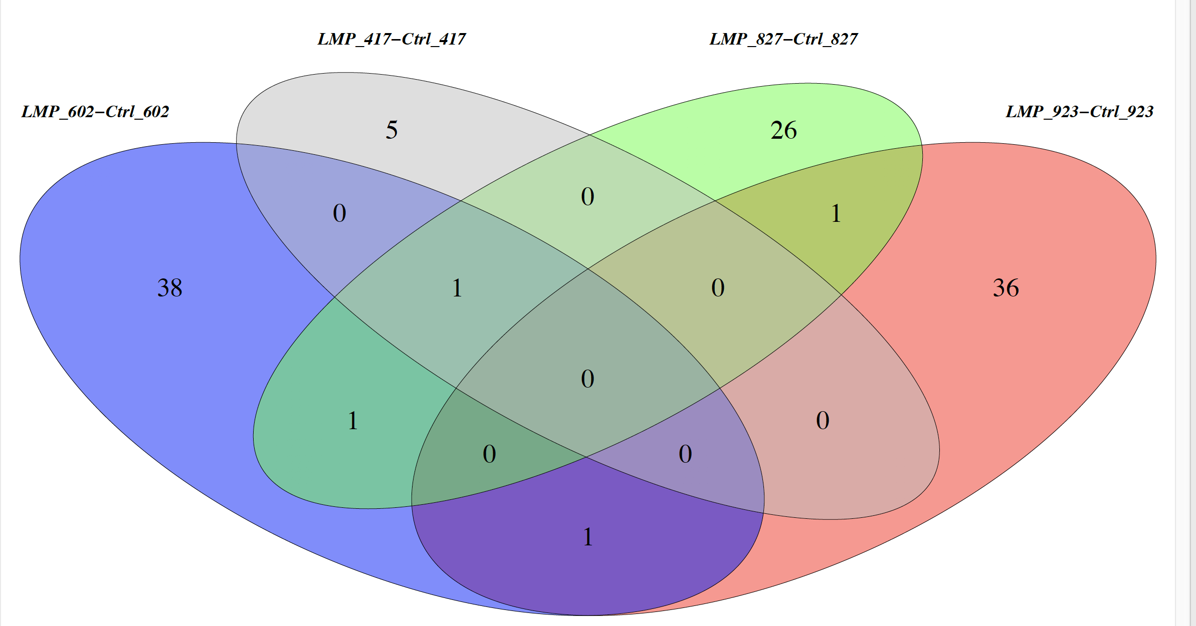
overlap of DEGs for each drug treatment

Slide 7
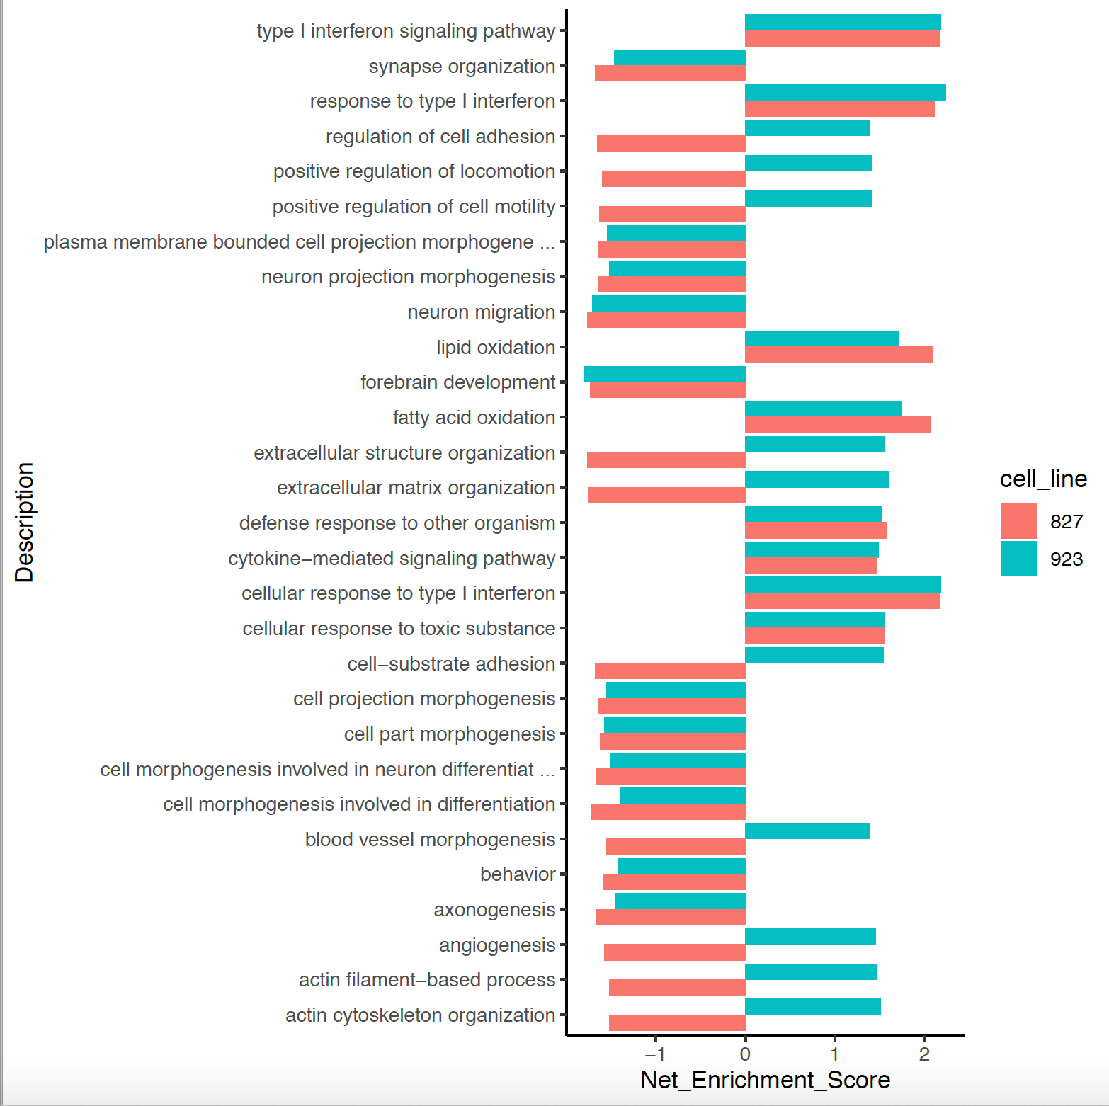
overlap of significant pathways
and their net enrichment score

